Slide 1




Communication-Efficient Training Workload Balancing for Decentralized Multi-Agent Learning
Seyed Mahmoud Sajjadi Mohammadabadi¹
Lei Yang¹, Feng Yan², and Junshan Zhang³
¹University of Nevada, Reno ²University of Houston ³University of California, Davis
44th IEEE International Conference on Distributed Computing Systems, July 25, 2024

Slide 2

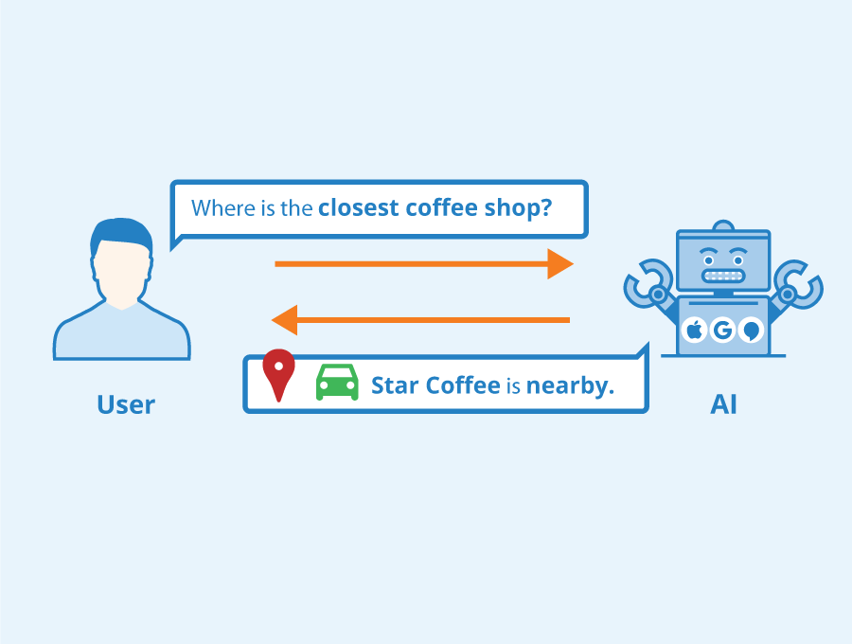




Centralized Machine Learning
Computer vision
High communication demand
Natural Language Processing (NLP)
Security / privacy issues
Data
Server
Speech processing

Slide 3








Centralized Federated Learning
Heterogeneity issues
Computation
Communication
Dataset/task size
Communication bottleneck
Server

Slide 4


Centralized Federated Learning — Literature Review
Agent-side
Server-side
Agents
Requires a central server
Privacy concerns
Communication bottleneck - SPoF
Scalability challenges
Aggregator server
Computing server
Centralized Federated Learning
HB McMahan, 2016
TiFL and FedAT, Z Chai, 2020 and 2021
Split Learning
P Vepakomma, 2018
Local loss FL, DJ Han, 2021
SplitFed, C Thapa, 2022

Slide 5
Decentralized Federated Learning
Improved robustness
Better scalability
Heterogeneous devices
Communication bottleneck

Slide 6
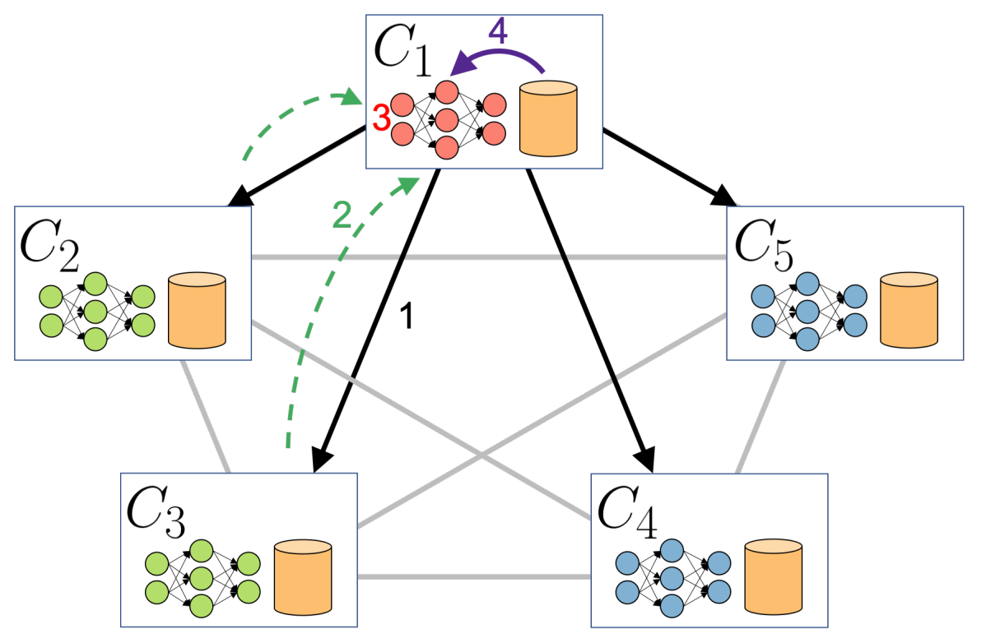
Literature Review - Existing Solutions and Limitations
Decentralized Machine Learning (DML)
Solutions: Peer-to-peer communication.
Gossip Learning, R Ormándi, 2011.
Braintorrent, AG Roy, 2019
GossipFL, Z Tang, 2022
Device heterogeneity

Slide 7
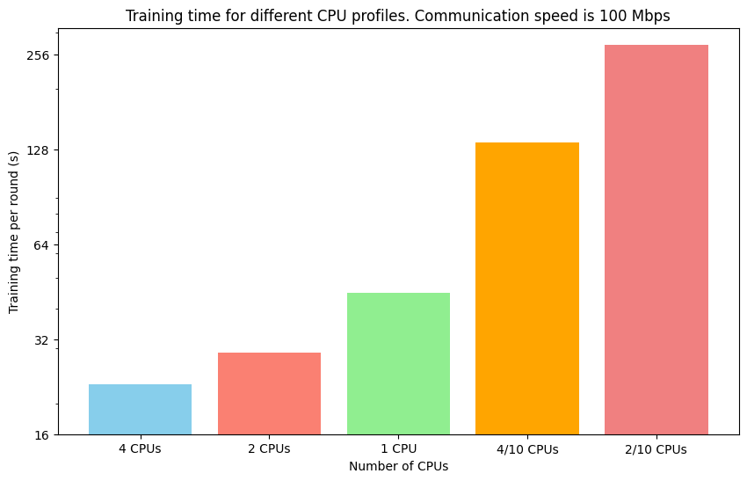
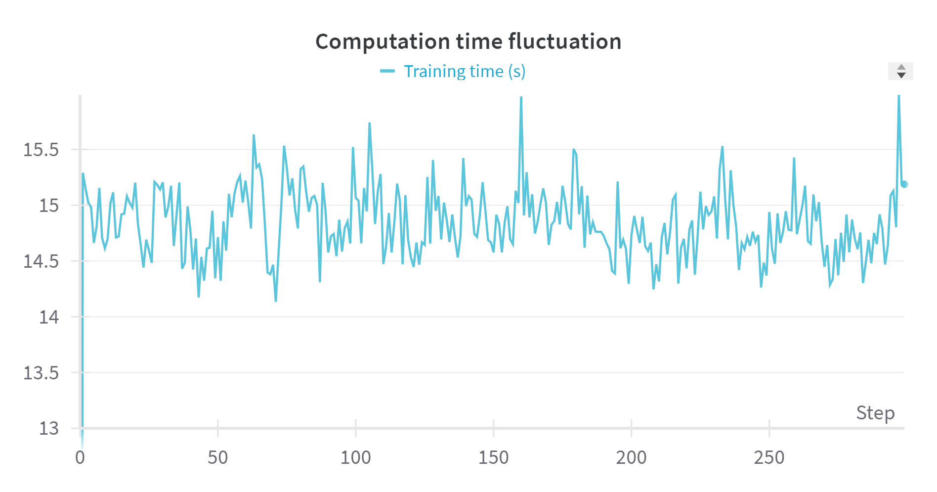
Heterogenous Training Time — Computation Heterogeneity
Training time fluctuation
Training time difference

Slide 8
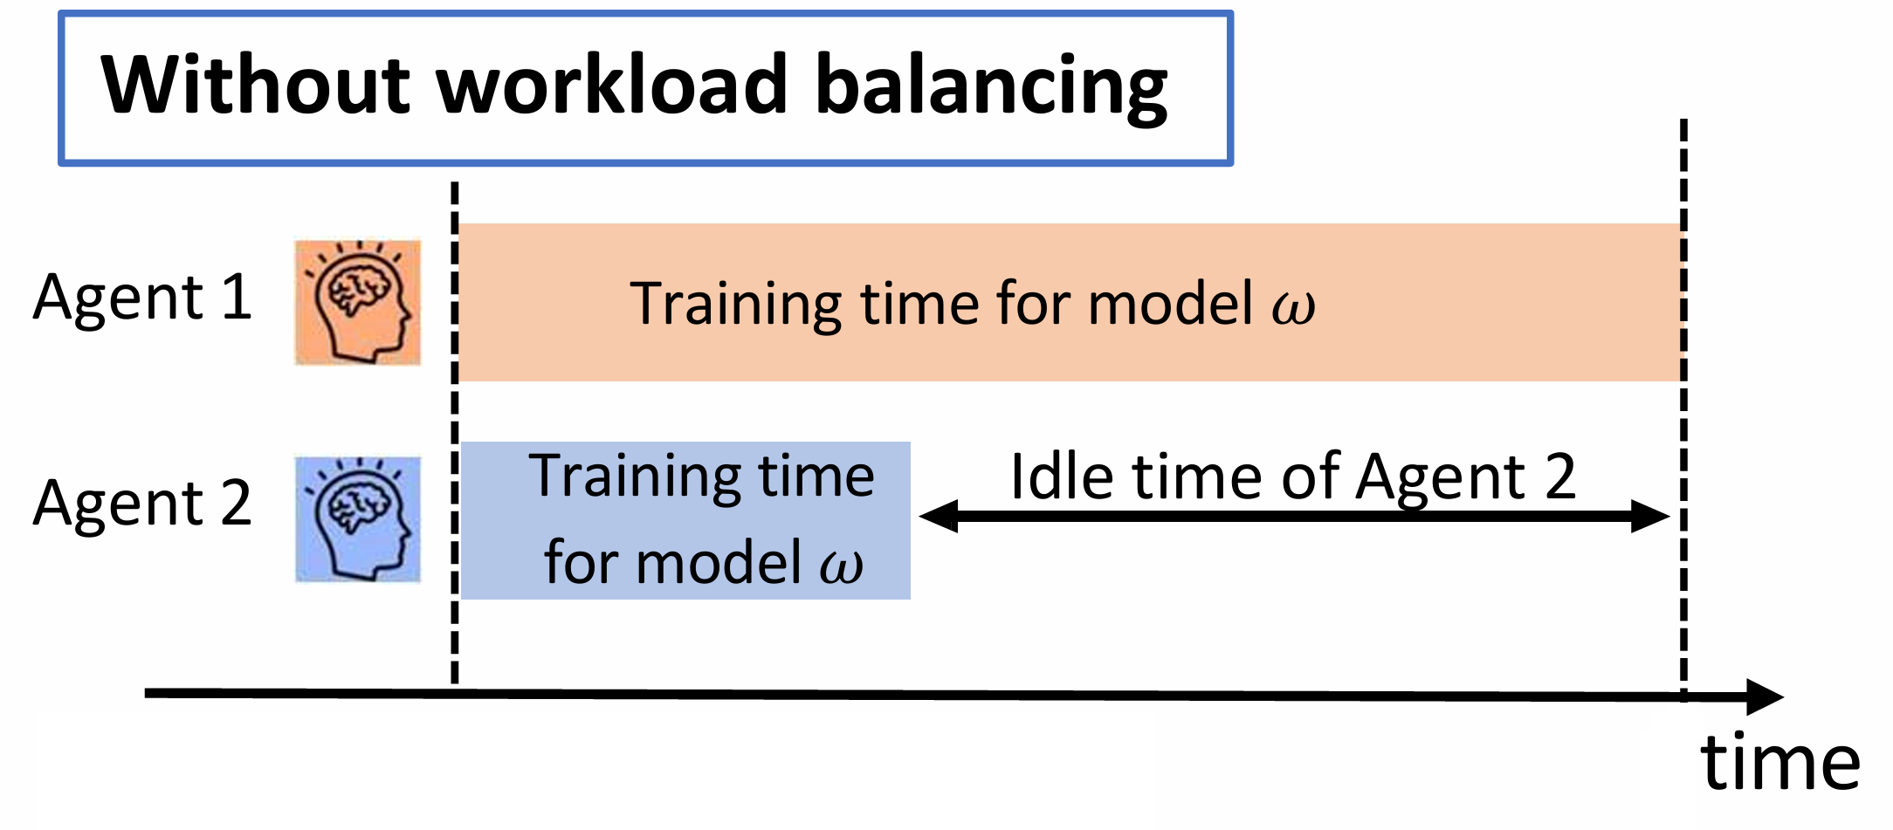
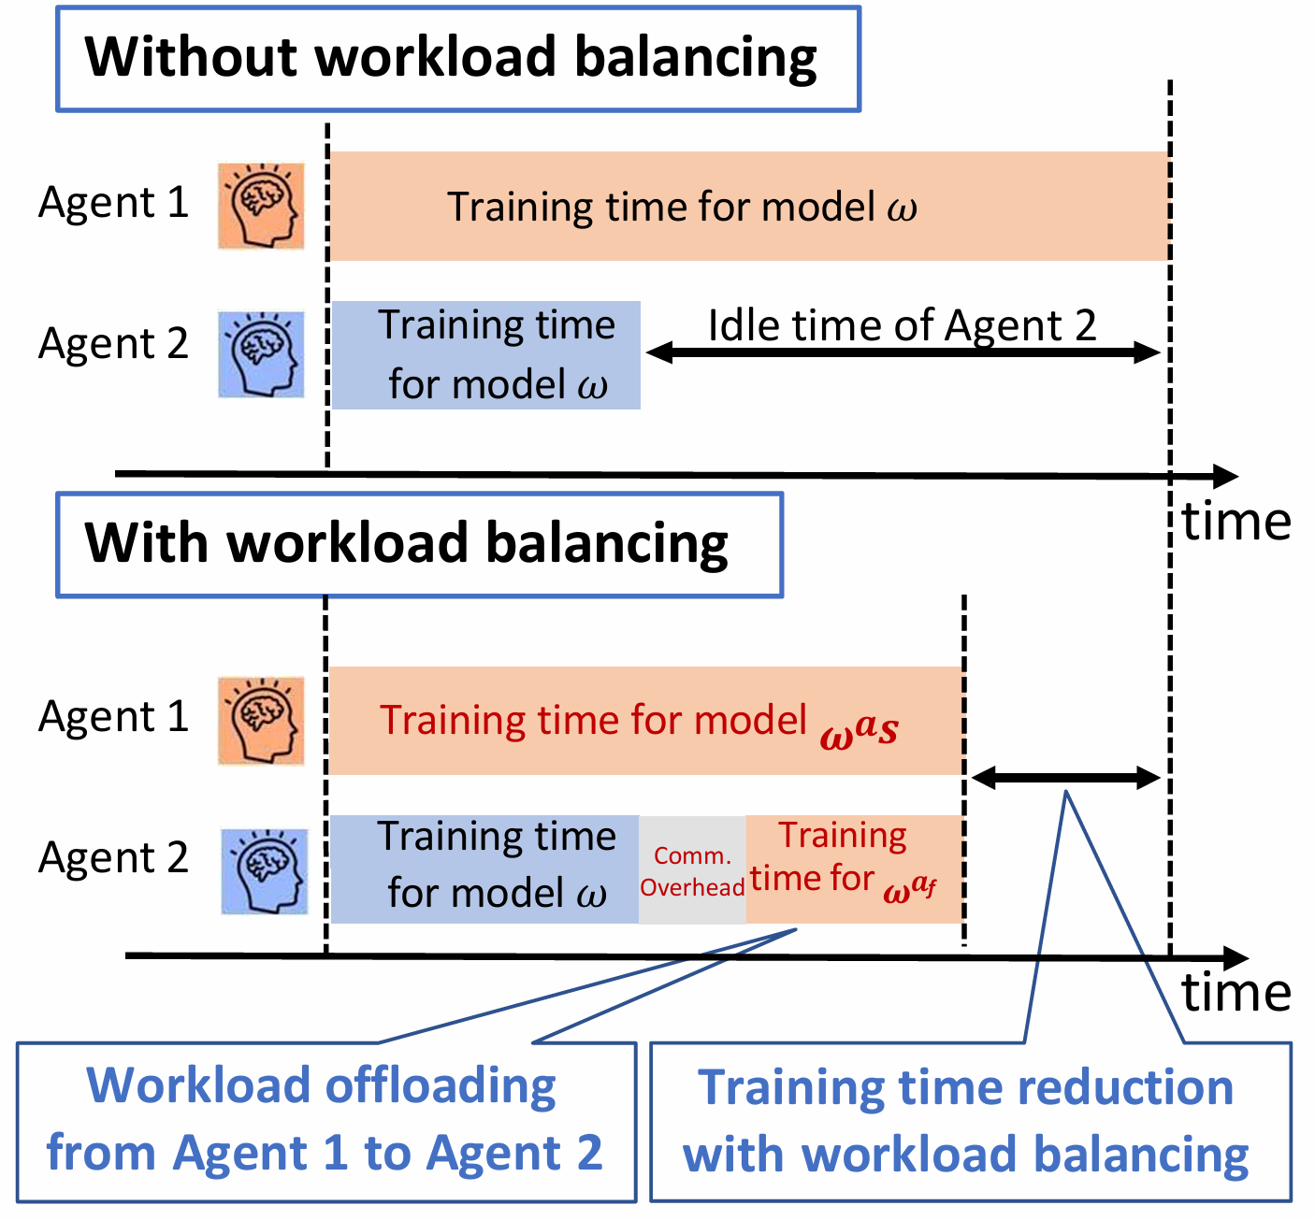
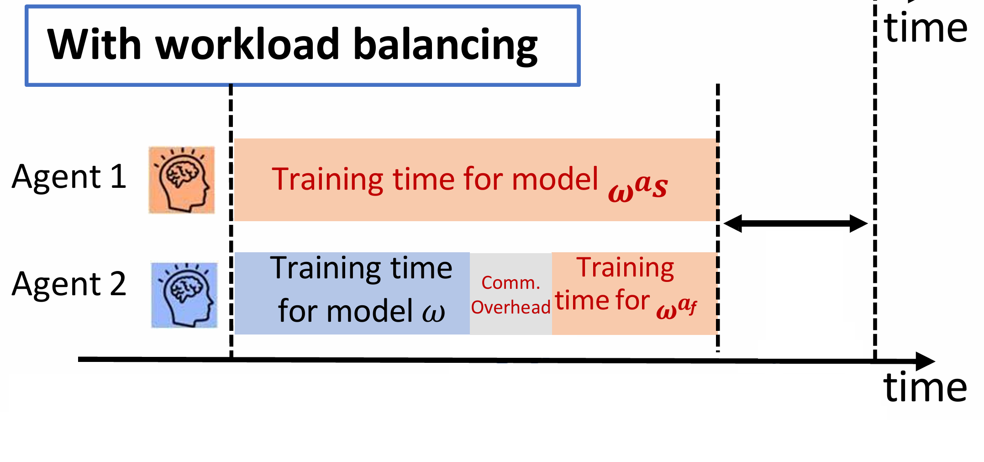
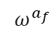
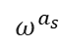
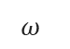
Communication-Efficient Training Workload Balancing
Slow agent hinder training
Imbalance training time
$$ω^{}$$
$$ω^{a_{s}}$$
$$ω^{a_{f}}$$
Slow agent
Fast agent
Workload offloading from Agent 1 to Agent 2
Training time reduction with workload balancing

Slide 9
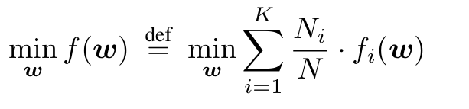
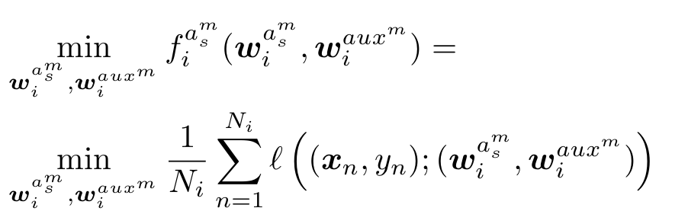
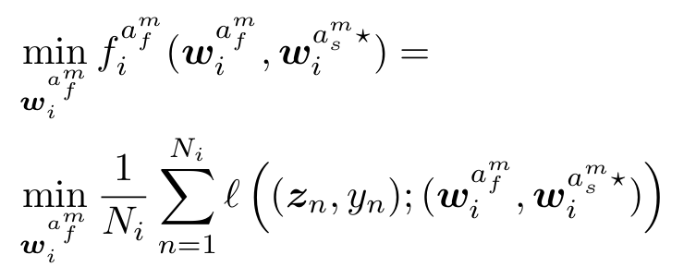

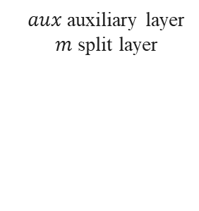

Decentralized Multi-Agent Learning (DML)
Paired agents’ optimization problem
$aux$ auxiliary layer
$m$ split layer
Goal: minimizing time
$x$ training sample
$y$ label
$z$ intermediate data

Slide 10
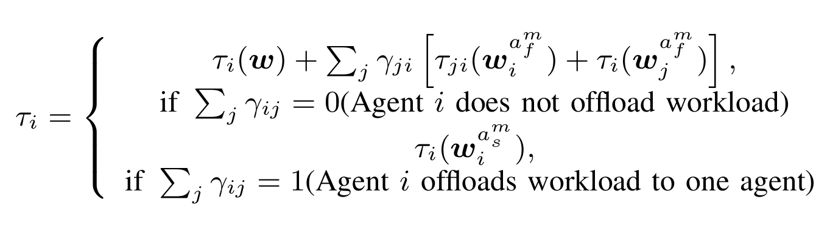

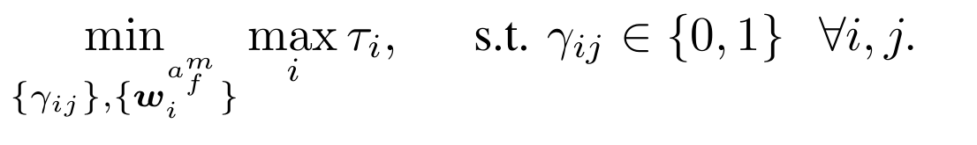
Training Time of DML
Integer programming
Pairing strategy
Workload split

Slide 11

DML Training Challenges
Pairing strategy
4
1
3
How to pair agents?
2

Slide 12
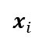
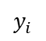
DML Training Challenges
Workload split
$$x_{i}$$
$$y_{i}$$
Communication synchronization
How to split workload?

Slide 13
Key Observation - Heterogeneity Impacts on Training
Factors: communication, processing, model splitting
Trade-off: less compute, more transfer
Dynamic offloading is the key for optimal training time
Minimum training time

Slide 14


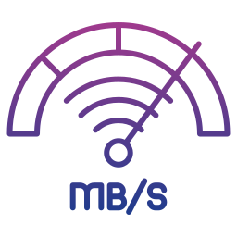
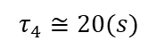
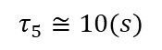
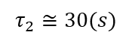
Training Workflow - Agent Pairing
Agent | Estimated time (s)
1 | 20
2 | 30
3 | ∞
4 | 20
5 | 10
$$τ_{5}≅10(s)$$
5
Agents share processing speed and training time (slowest first).
Each agent observe connection speed, estimates paired training time, send back estimated time
Each agent choose a neighbor minimizing training time.
1
2
4
$$τ_{2}≅30(s)$$
$$τ_{4}≅20(s)$$
3

Slide 15
Training Workflow - Local Model Update
1
5
Fast agents train local models independently
Slow agents train locally & receive fast agent support
2
4
3
2
Local-loss training

Slide 16
Training Workflow - Model Aggregation and Update
3
1
5
3
3
2
4
3
3
3
2
Model aggregation using All-Reduce

Slide 17
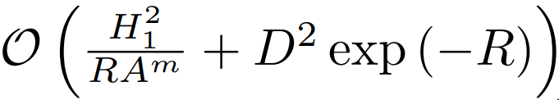
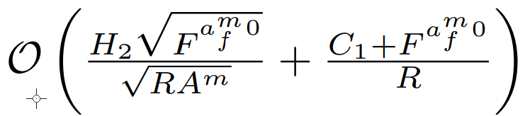
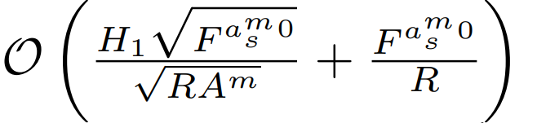
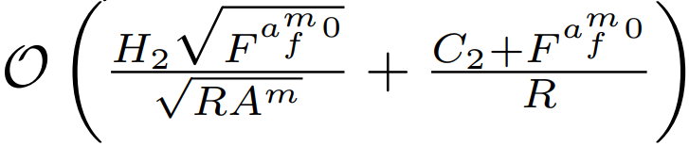
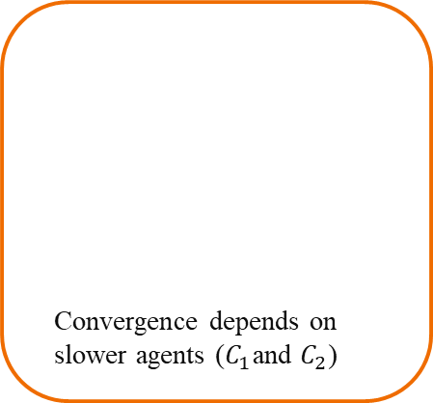
Convergence Analysis
Theorem: Slow and fast agent-side models for both convex and non-convex functions converge with ComDML algorithm
 | Slow-agent side | Fast-agent side
Convex
Non-convex
Similar convergence rates to FL
Convergence depends on slower agents ($C_{1}$and $C_{2}$)

Slide 18
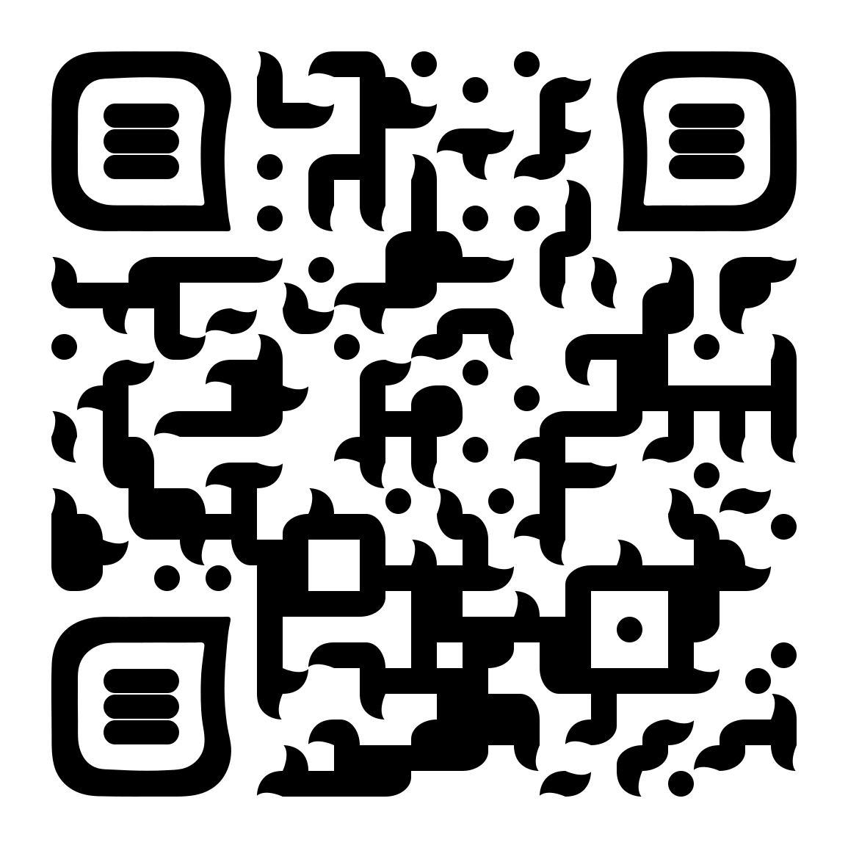

Evaluation Setup
Implementation:
Hardware: Intel Xeon(R) CPU & NVIDIA GeForce GTX GPUs
Software: Python, PyTorch
Heterogeneous simulation environment
4, 2, 1, 0.5, and 0.2 CPUs.
0, 10, 20, 50, and 100 Mbps
Model Architecture:
ResNet-56
ResNet-110
Baselines:
FedAvg
BrainTorrent
Gossip Learning
AllReduce
Datasets:
CIFAR-10, CIFAR-100, CINIC-10
Non-IID variants for label distribution skew

Slide 19
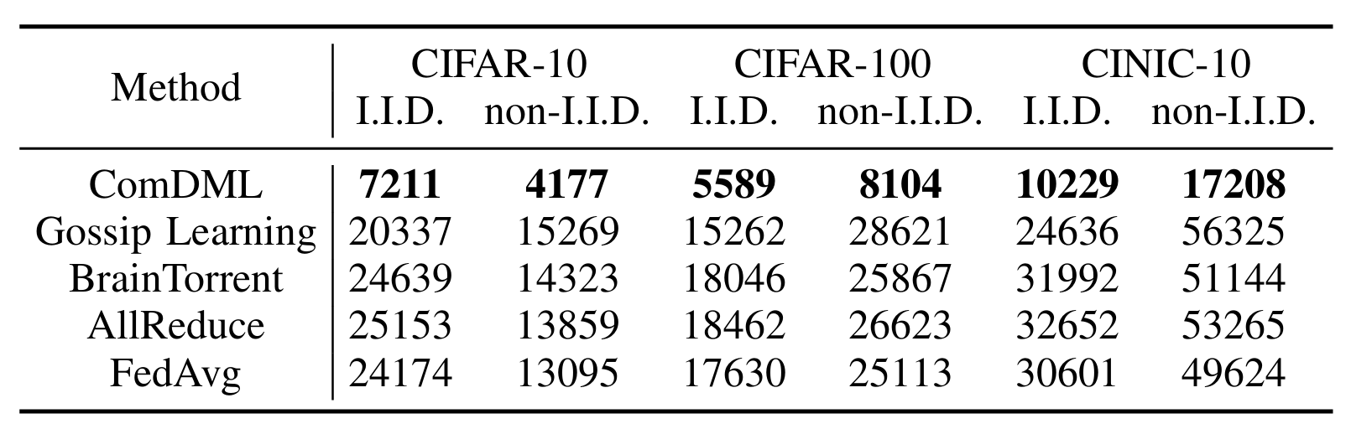
Training Time Improvement
Fast
70%+ reduction in training time

Slide 20
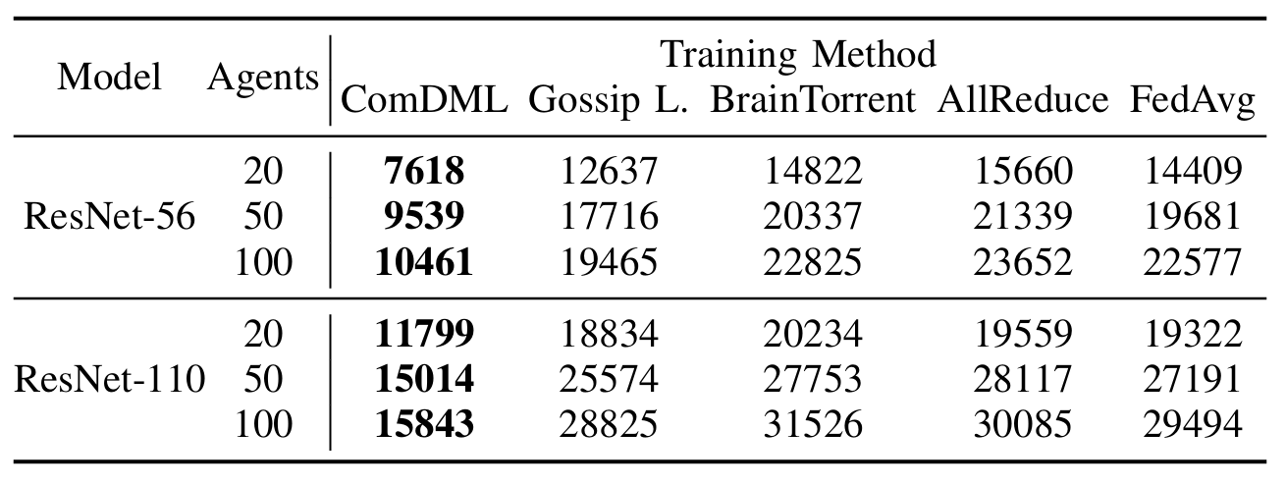
Scalability
Scalable

Slide 21
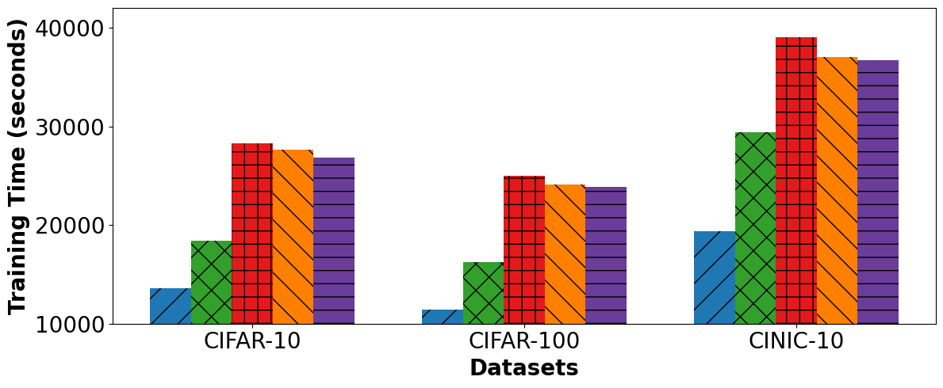
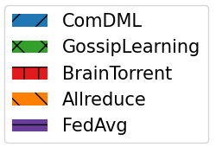
Robustness under Different Network Topologies
Under limited connections (20% links)
Robust
Training time difference

Slide 22
Privacy Preservation
Intermediate data
Model Parameters
Secure
 | No protection | Distance correlation | Patch shuffling | Differential privacy
Accuracy | 84.6% | 81.7% | 83.2% | 77.6%
Intermediate data: P Vepakomma, Nopeek, 2020 And D Yao, Patch shuffling, 2022
Model Parameter: Differential privacy, M Abadi, 2016

Slide 23
Conclusion
We propose a serverless framework for decentralized ML
Resource-Aware: Balances workload for parallel updates.
Convergence Guarantees: Provides theoretical convergence behavior.
Fast: Reduces training time significantly while maintaining accuracy.
Scalable: Accommodates an increasing number of heterogeneous agents.
Robust: Handles diverse network conditions.
Privacy-Preserving: Supports various privacy mechanisms.
ComDML tackles stragglers in decentralized ML through dynamic workload balancing, achieving faster training without a central server

Slide 24


Thank you! Questions?
Mahmoud Sajjadi, Mahmoud.Sajjadi@unr.edu / Mahmoud.Sajjadi@gmail.com
This work is supported by National Science Foundation

